Slide 1


Constructing a 3D Model Using 2D Parameter Inputs
Submitted as Engineering Project by Umut Naderi
Supervised by Assist. Prof. Dr. Dionysis Goularas
Yeditepe University
Department of Computer Engineering

Slide 2
Outlines
Introduction
Background
Analysis and Design
Implementation
Tests and Results
Conclusion

Slide 3
Introduction
What is 3D environment?
What are the benefits of using 3D environment?
Why do we need parametric modeling?
Lumbar Vertebrae as a parametric model
The aim of this project

Slide 4
Background for Related Works
One research has been made by a group involving Nicola Cappetti, Alessandro Nadeo, Arcangelo Pellegrino, Giovanni Francesco Solitro and Francesco Naddeo in January 2010.
It is directly related with parametric modeling of lumbar vertebrae.
They analyzed the size, weight and the proportions of the body of a vertebra.
They grouped the elements according to their characteristics such as structure, edge and surface.
Structure group handled the parametric data involving dimensions, position and orientation while the edge group handled the tangency of the border curves

Slide 5
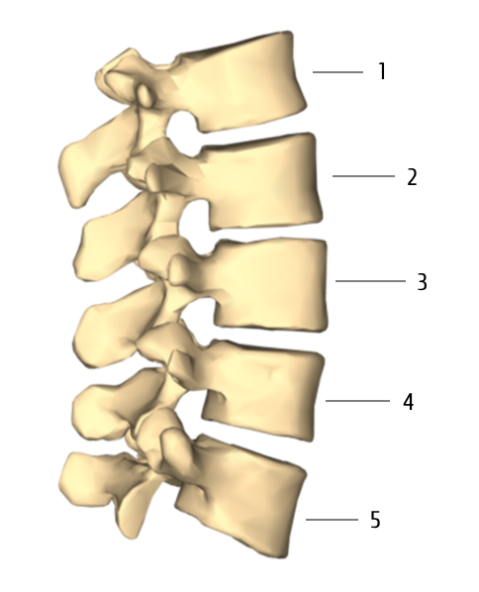
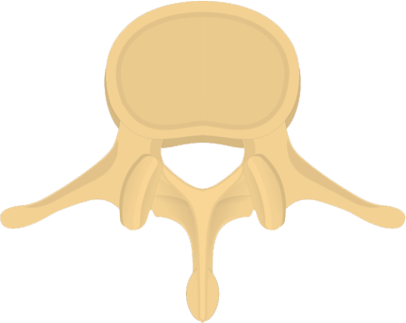
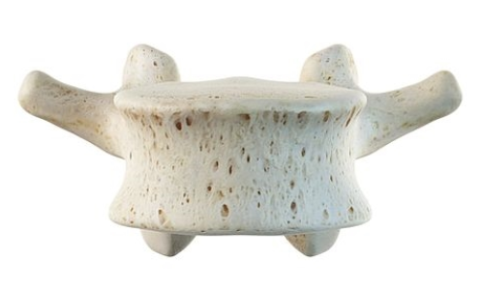
Analysis & Design: The Lumbar Vertebrae
Five separate vertebrae
Named from 1 to 5 starting from top.
Roughly cylindrical shape.
Height, width and length values.

Slide 6
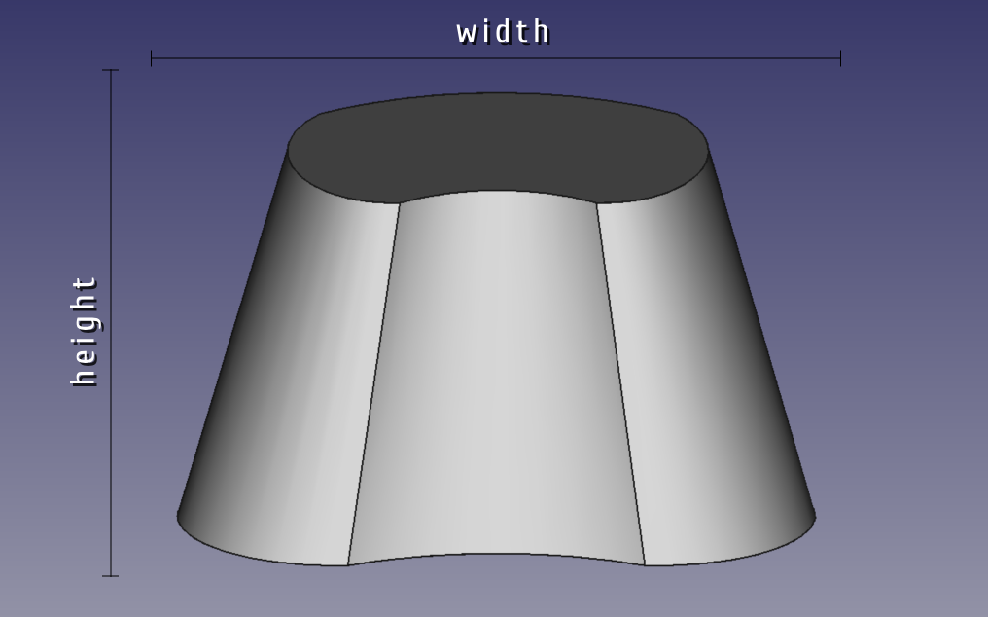
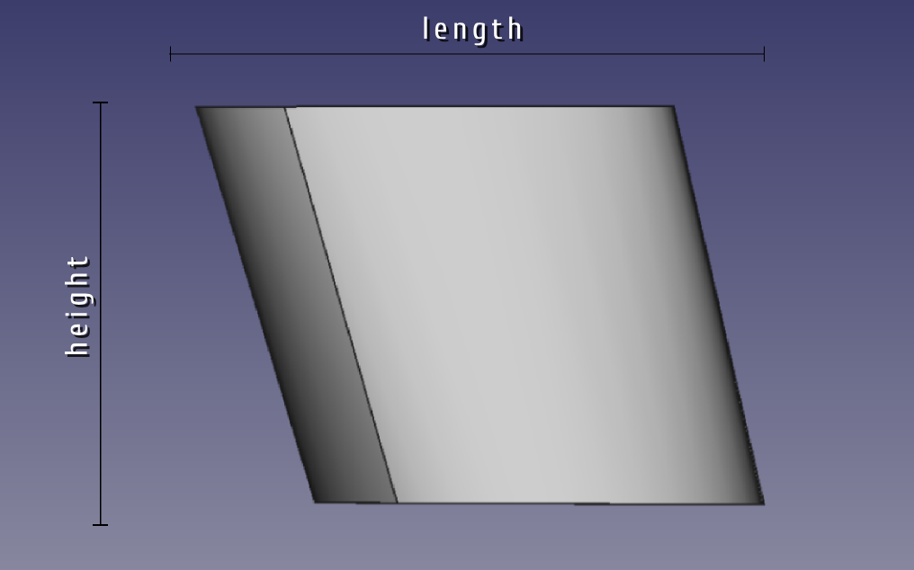
Analysis & Design: Addressing the Variables
Main aim is to create a 3D model of lumbar vertebrae assembled by a data set.
How are the variables addressed on our model?

Slide 7
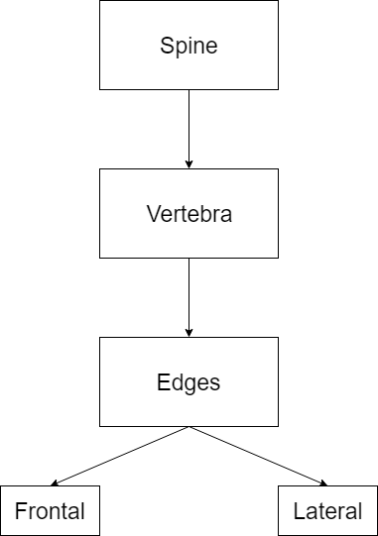
Analysis & Design: The General Structure

Slide 8
Analysis & Design: Pseudocode
Function UpdateImageToPoint
IF view == front
THEN displayImage
drawCircle to point x and y, color yellow
point <- position
spine->Vector_Vertebrae.at(vertexCount/4).Vector_Vertex_Frontal.at(vertexCount%4).setx(pos.x)
spine->Vector_Vertebrae.at(vertexCount/4).Vector_Vertex_Frontal.at(vertexCount%4).setz(550 - pos.y)
drawCircle to point x and y, color yellow
updateImage
ELSE IF view != front
THEN display image
drawCircle to point x and y, color yellow
point <- position
spine->Vector_Vertebrae.at(vertexCount/4).Vector_Vertex_Lateral.at(vertexCount%4).sety(pos.x)
spine->Vector_Vertebrae.at(vertexCount/4).Vector_Vertex_Lateral.at(vertexCount%4).setz(pos.y)
drawCircle to point x and y, color yellow
updateImage

Slide 9
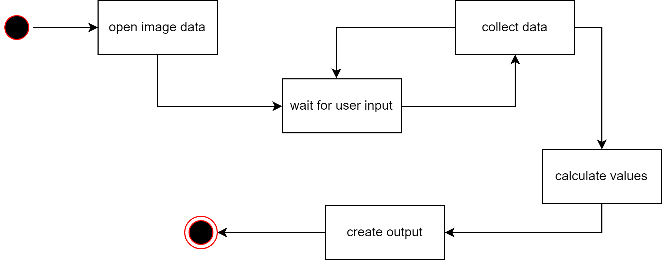
Analysis & Design: States of Progress

Slide 10
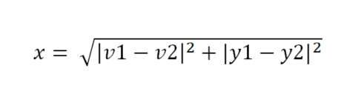
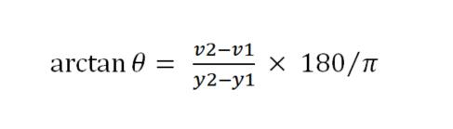
Analysis & Design: Calculations
Two important formulas
Calculation of the size of a side of an element;
Calculation of the rotation angle due to axis;

Slide 11



Implementation: Software Used
OpenCV
A library that can be used on multiple platforms for multiple purposes.
Primarily for computer vision applications.
Qt
Cross-platform application development framework.
Written in C++.
Supports OpenCV.
GUI Support
FreeCAD
An open source parametric 3D modeling application.
Has a console that supports Python macros.

Slide 12
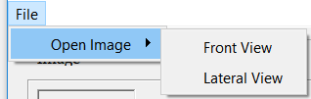
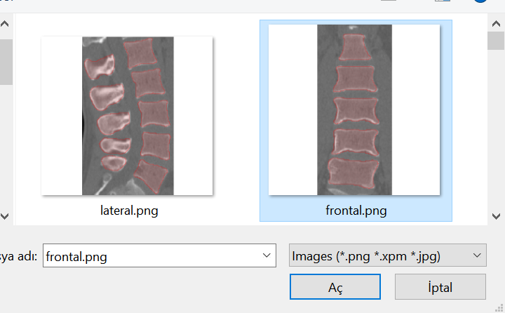


Implementation: User Interface
User is asked to select an image file.
Two different view angles.
Supports 3 different image file formats.
Mouse coordinates
Vertebra information
Preview screen as a guide

Slide 13
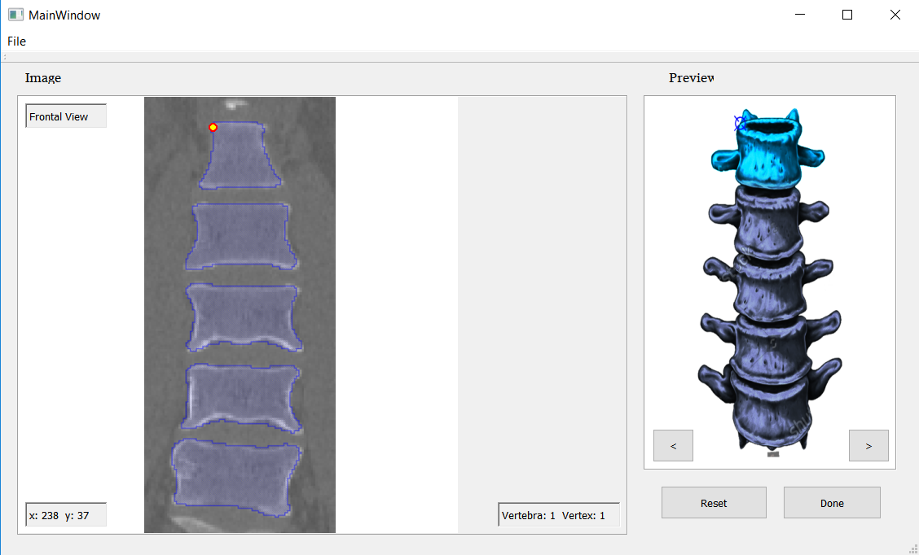
Implementation: User Interface

Slide 14
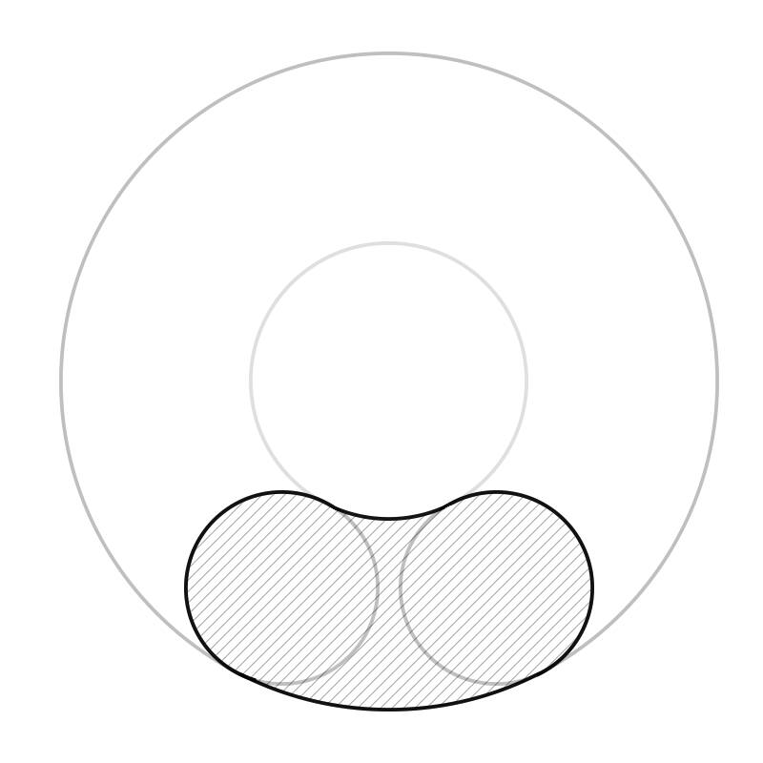
Implementation: 3D Model
Basic shape representing a vertebra was created using FreeCAD.
Sketch tools were used to create the top and bottom surfaces of the model.
Sketch was created using circle geometry.

Slide 15
Tests & Results
5 test cases were taken into account.
3 different aspects were tested:
Scaling
Positioning
Rotations

Slide 16
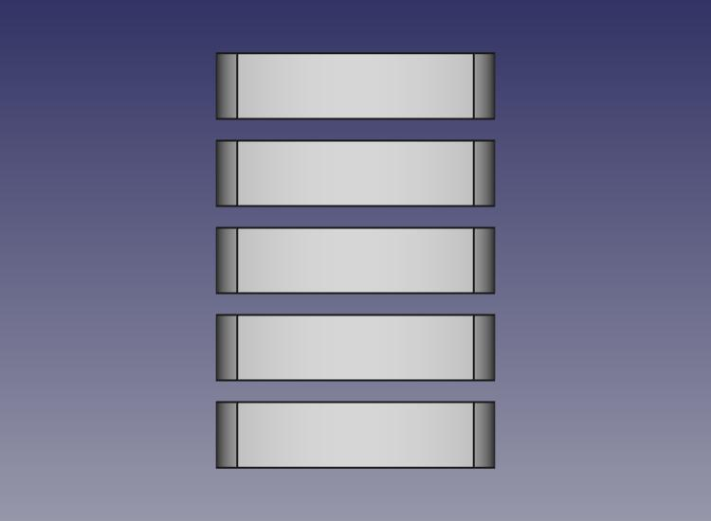
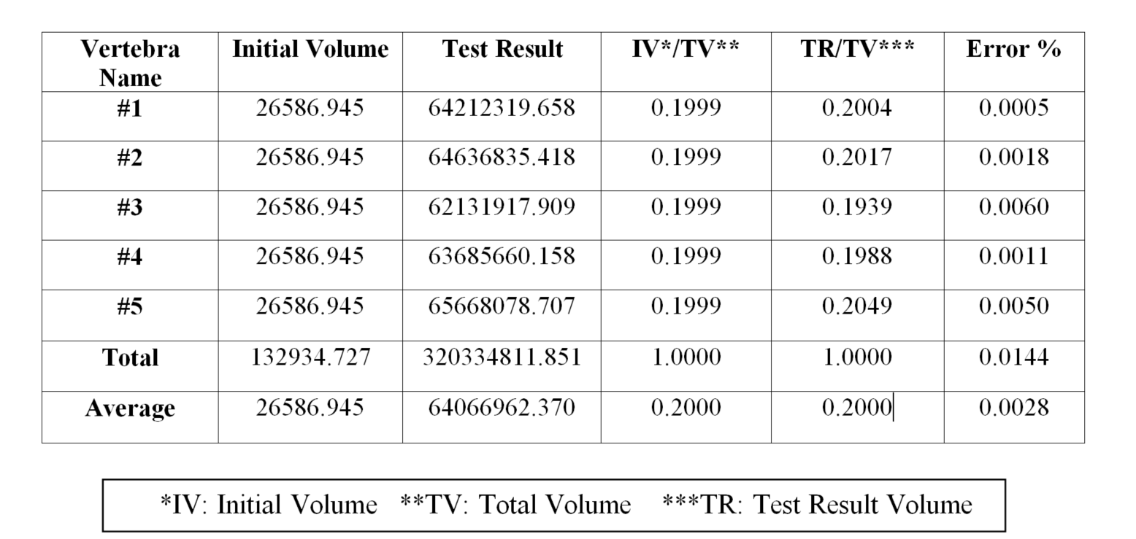
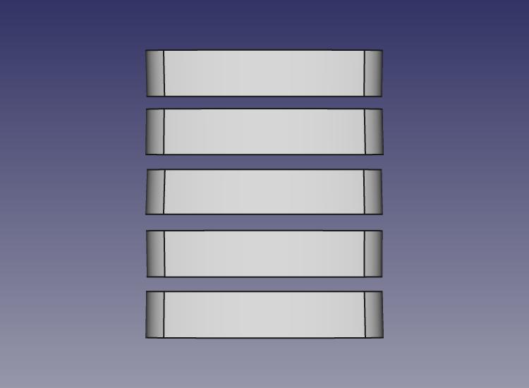
Tests & Results: Case 1 – Straight Alignment

Slide 17
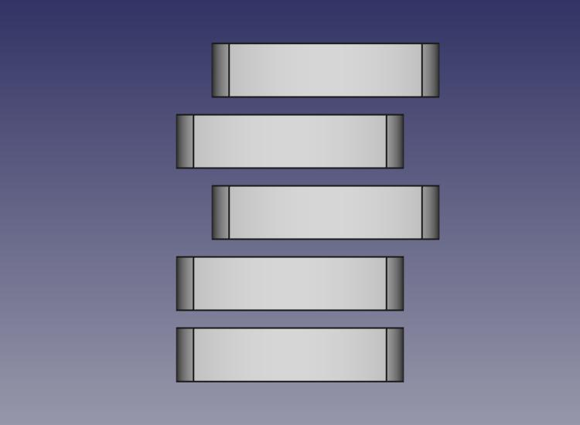
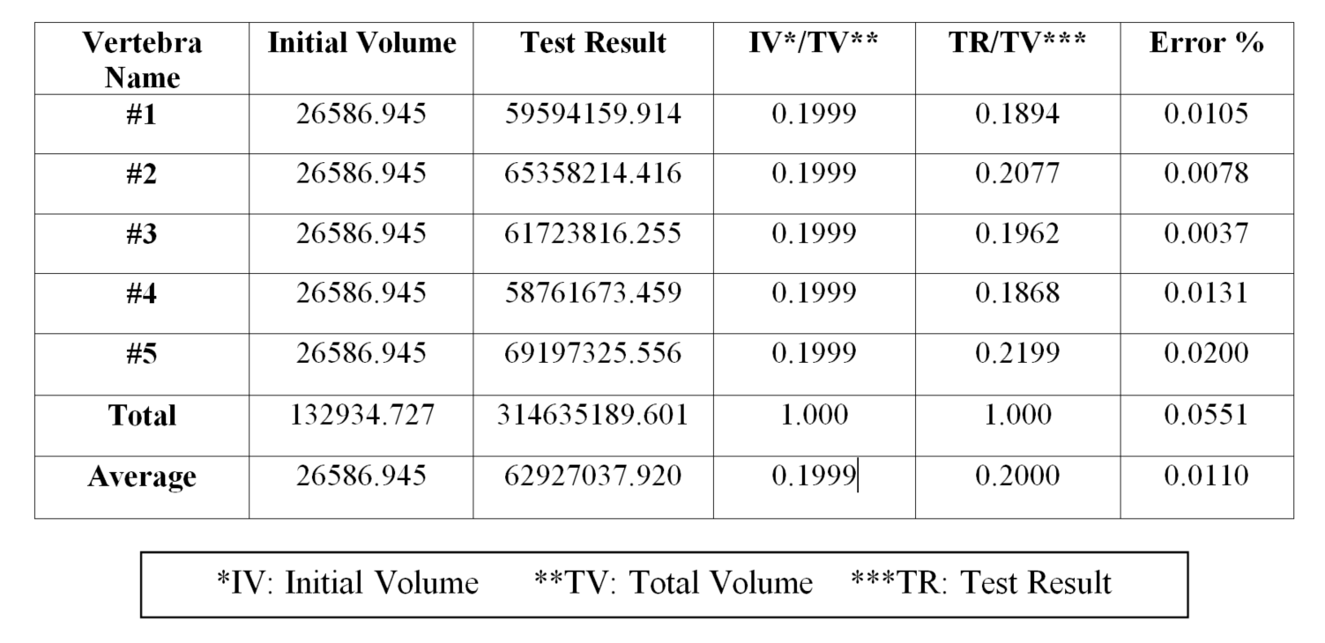
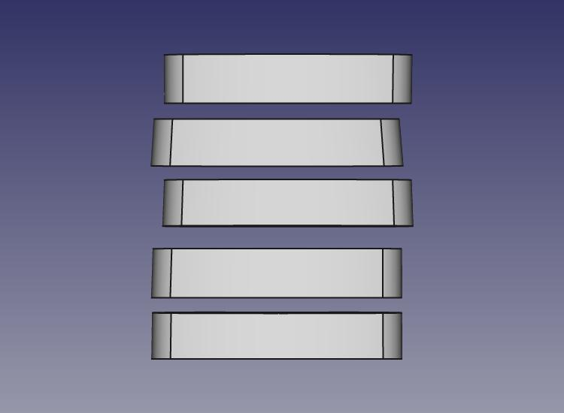
Tests & Results: Case 2 – Displacement of Two Vertebrae

Slide 18
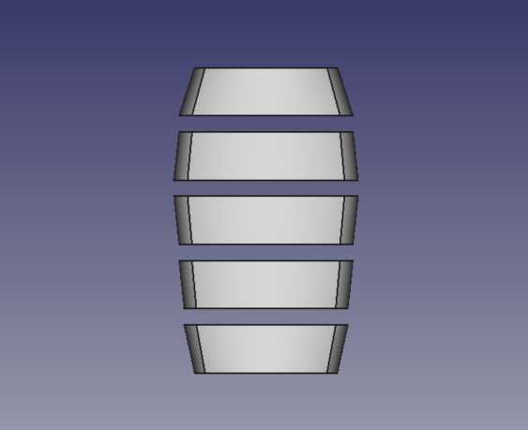
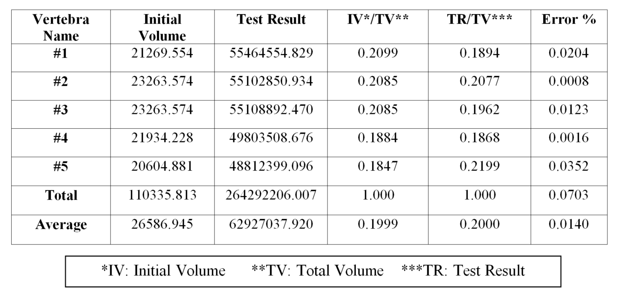
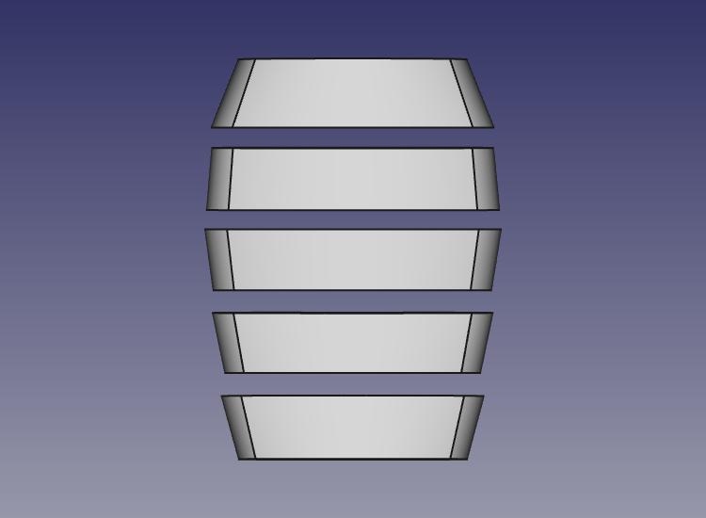
Tests & Results: Case 3 – Different Scales

Slide 19
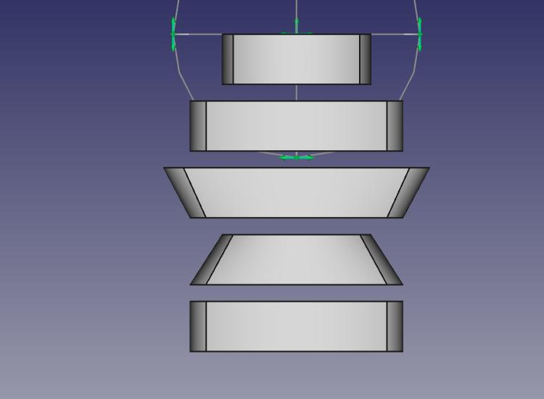
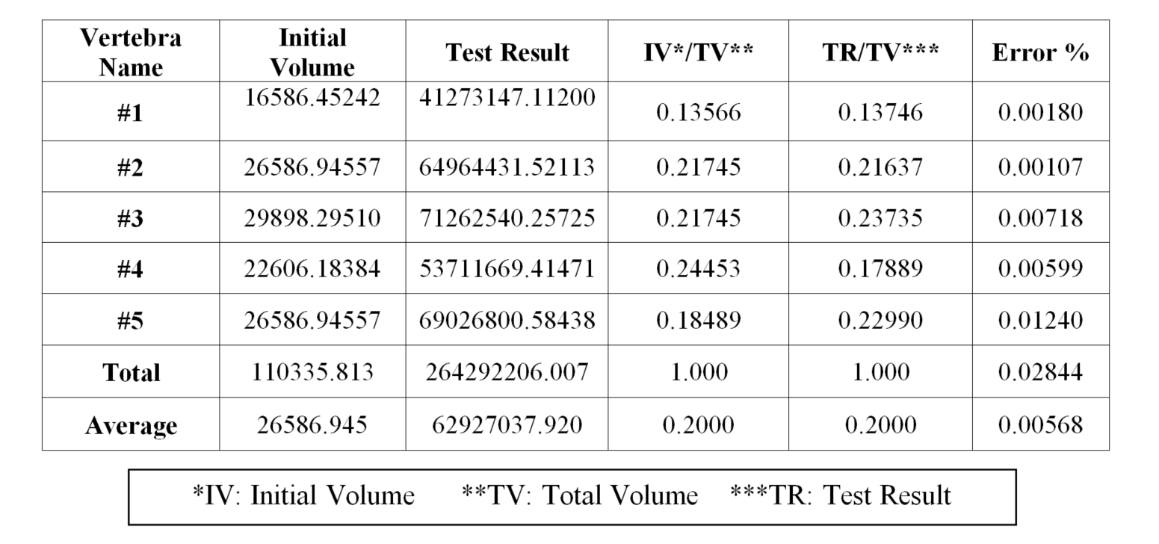
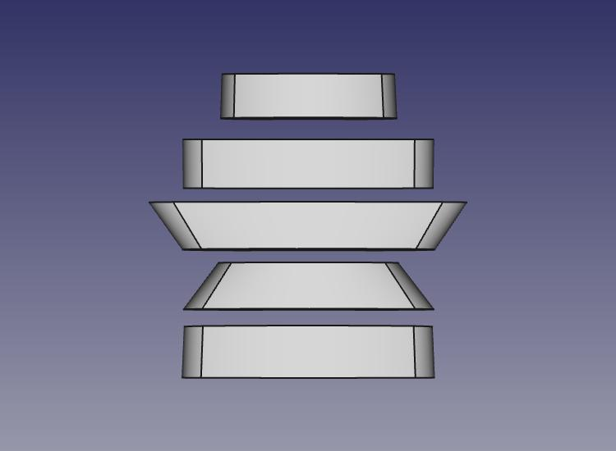
Tests & Results: Case 4 – Different Scales

Slide 20
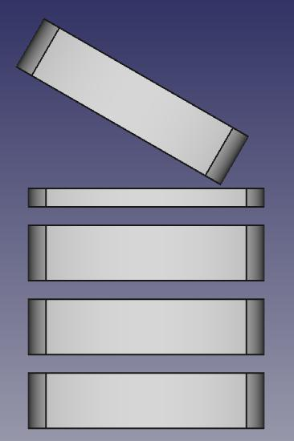
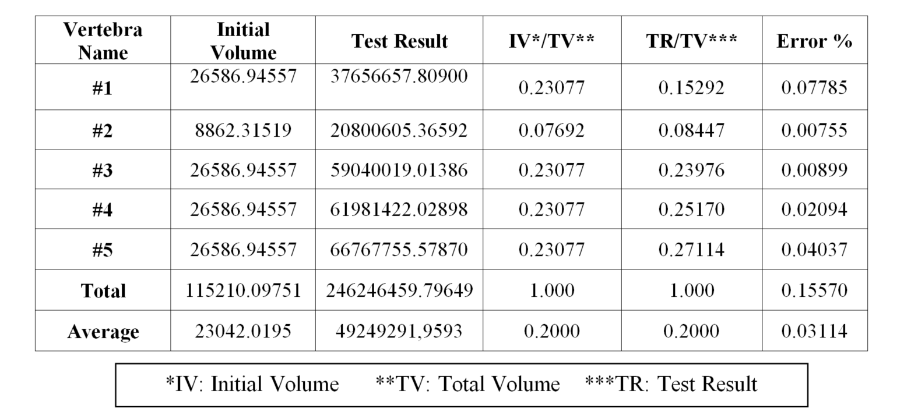
Tests & Results: Case 4 – Rotated Element

Slide 21
Conclusion
Average of 0.0126% error rate.
An accurate parametric 3D model was created.
Vertebra was built on a basic shape.
Basic user interface helps the user.
Future works:
More realistic shape
Data sets can be enlarged for precision

